Slide 1
Week 19 - 1 Blending and Stencils
5CM503 Virtual Environment Development
Dr Patrick Merritt

Slide 2
Contents
Mathematical functions for shaders.
Stencils
Blending

Slide 3
Blending
Transitions between effects

Slide 4
The story so far…
So far, we have made effects with very hard transitions.
When one effect ends another begins.
Often not the desired effect, we want to transition between effects in a controlled way.

Slide 5
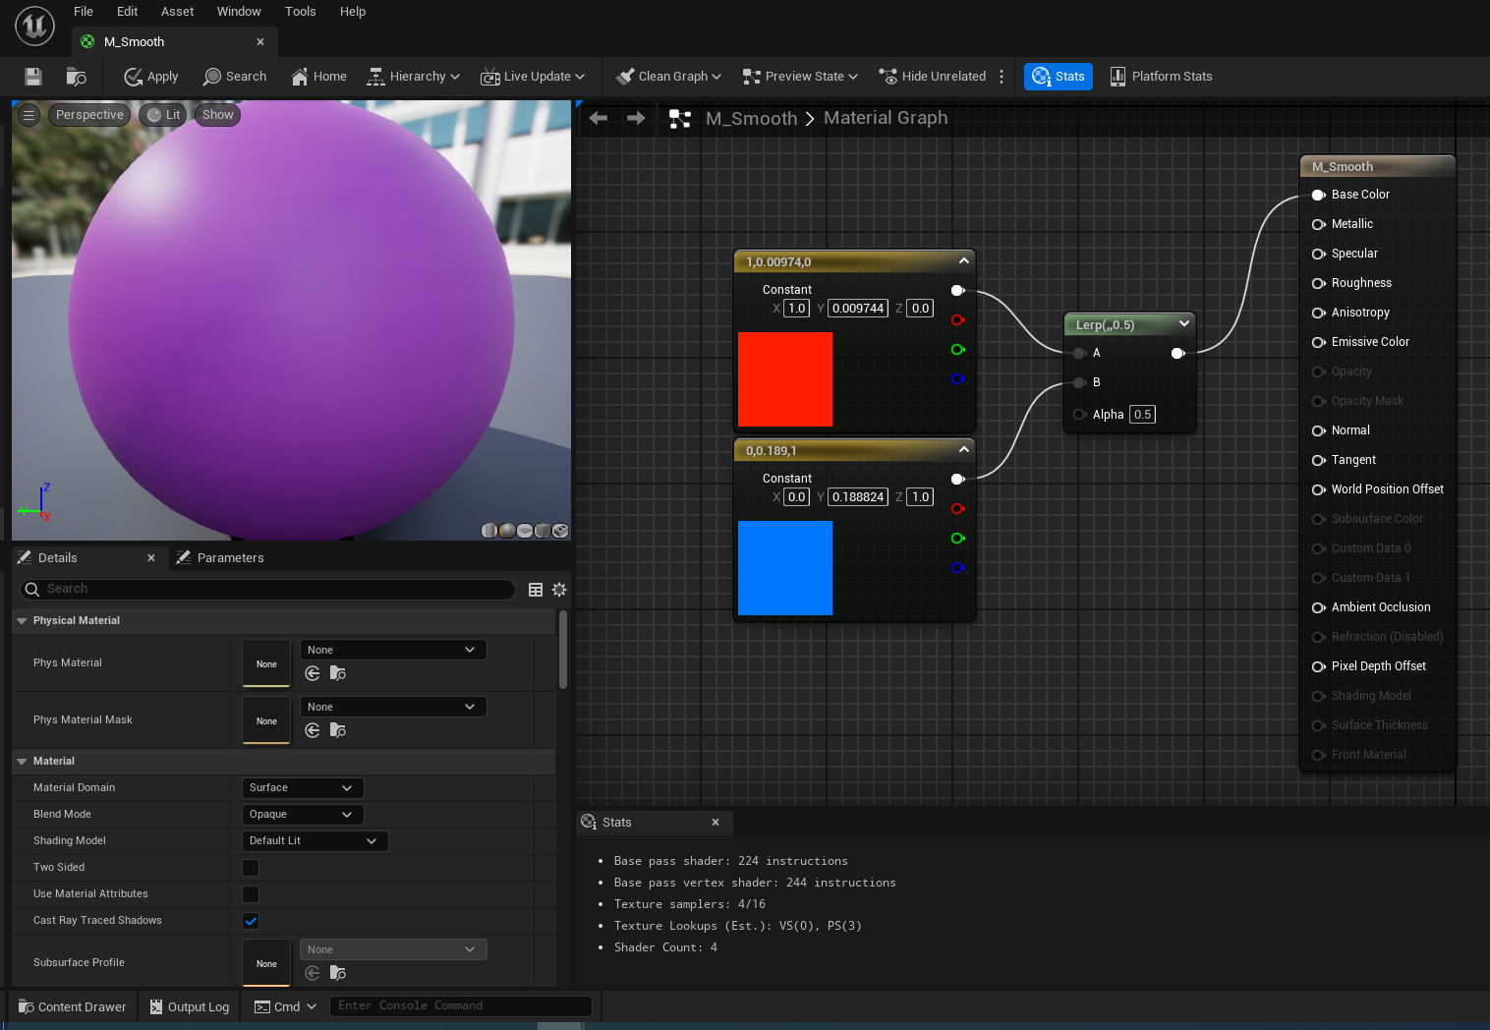
Lerp
Linear interpolation.
Blend input A with input B based on an alpha value.
Bias to A or B adjusted via the alpha value (0 – 1)

Slide 6
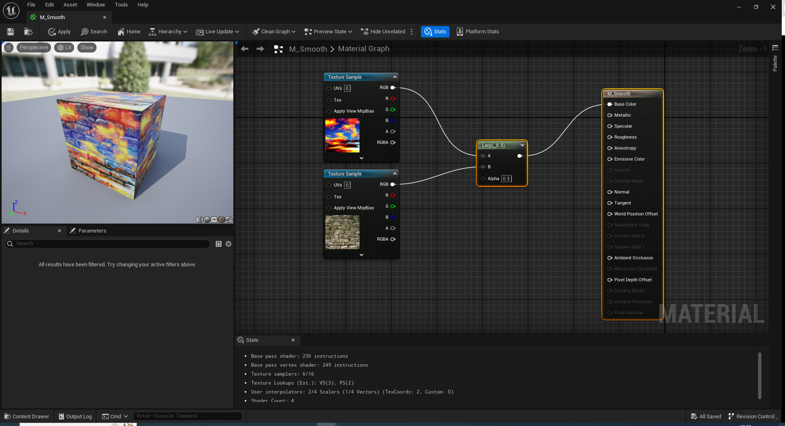
Lerp

Slide 7
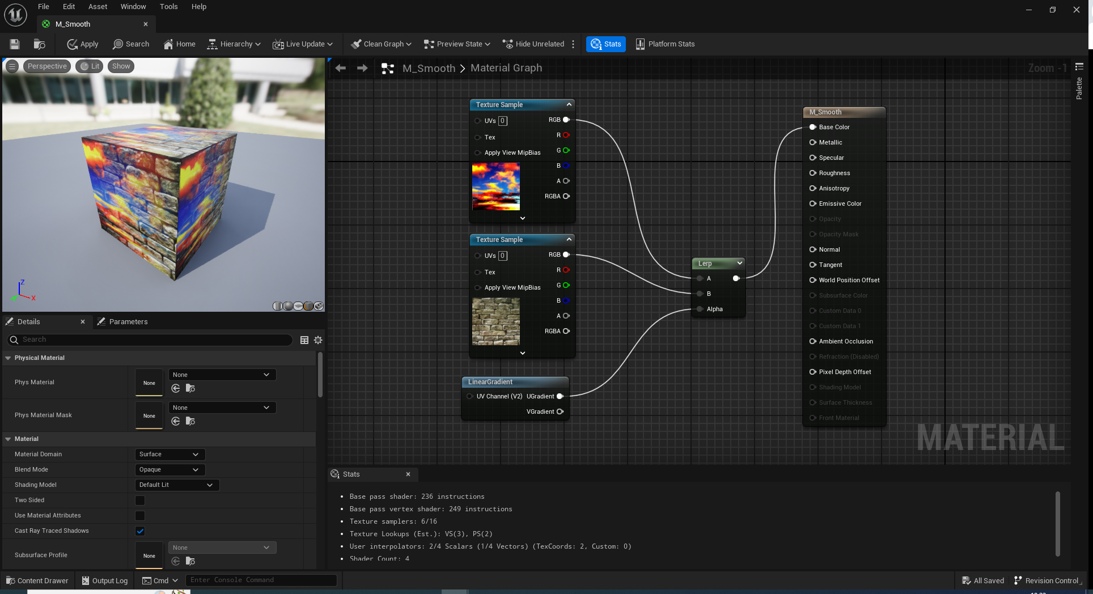
Lerp

Slide 8
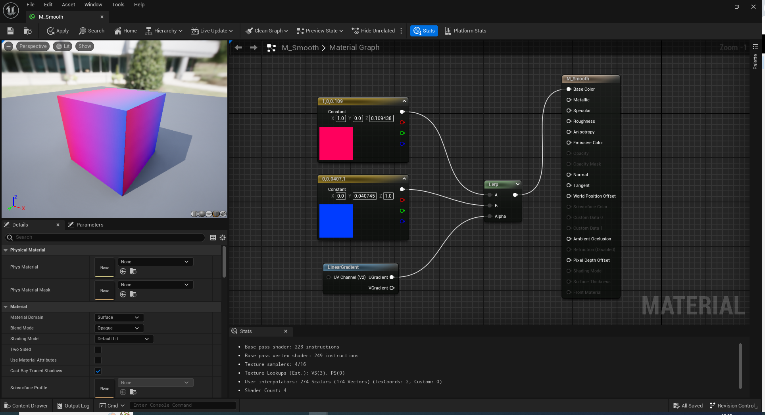

Slide 9
Smooth Step
Like Step, but with extra steps.
Below minimum value becomes 0.
Above the maximum value becomes 1
In between, become a gradient.

Slide 10
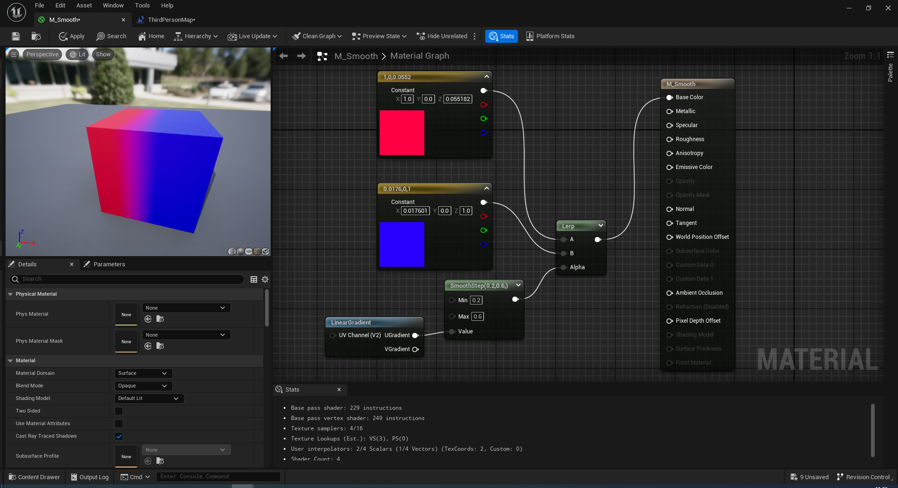

Slide 11

Noise
Sometimes, we don’t want effects to be clean and uniform.
We add noise to break up the uniformity.
http://kitfox.com/projects/perlinNoiseMaker/

Slide 12
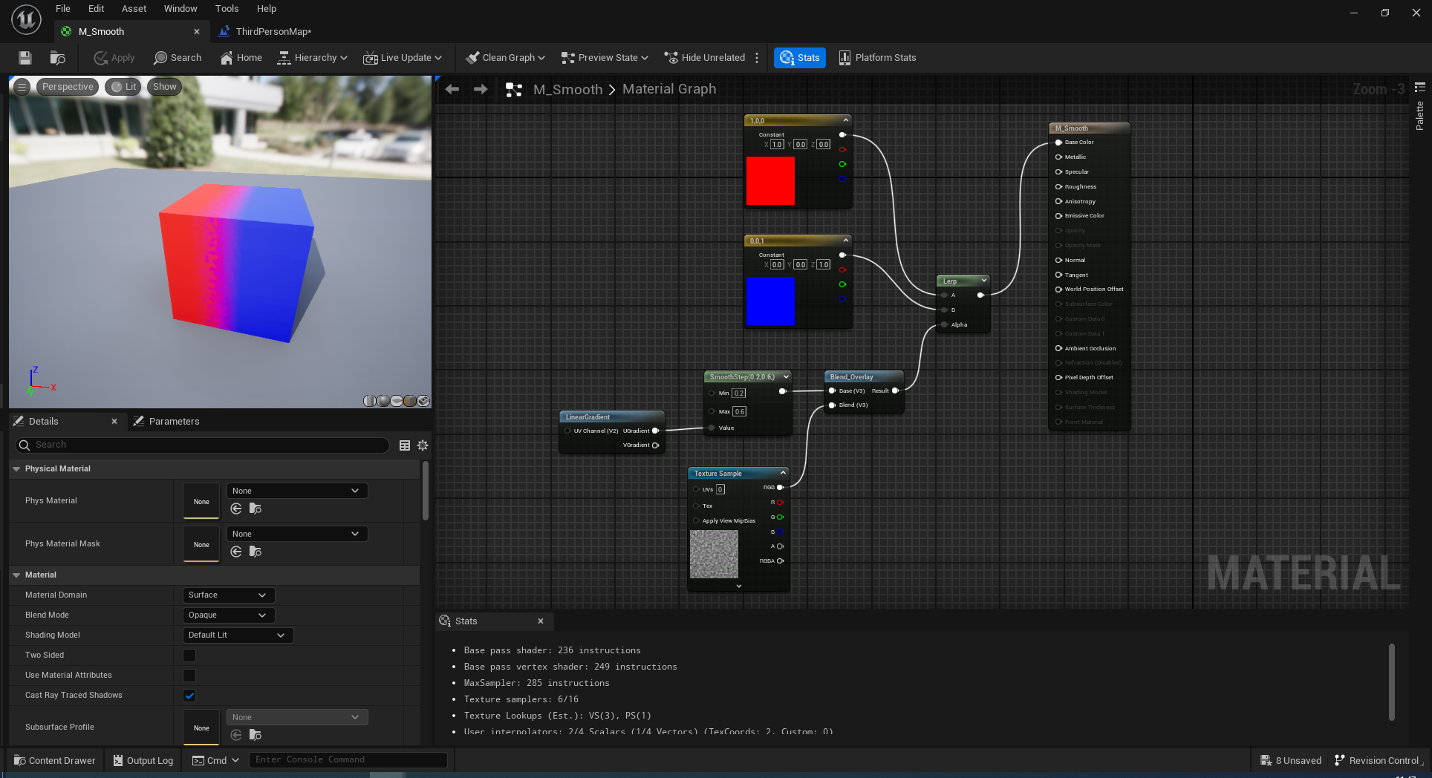
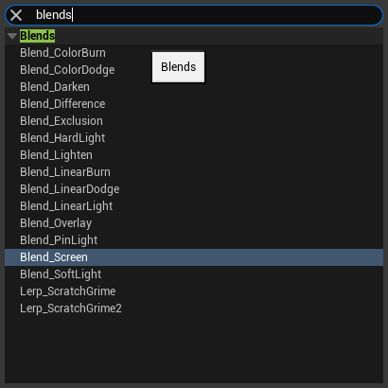
Blend functions
These are a series of mathematical functions which perform common complex blends.
Similar to Photoshop blends.
Documentation is here. Go and read this!
https://docs.unrealengine.com/4.26/en-US/RenderingAndGraphics/Materials/Functions/Reference/Blends/

Slide 13
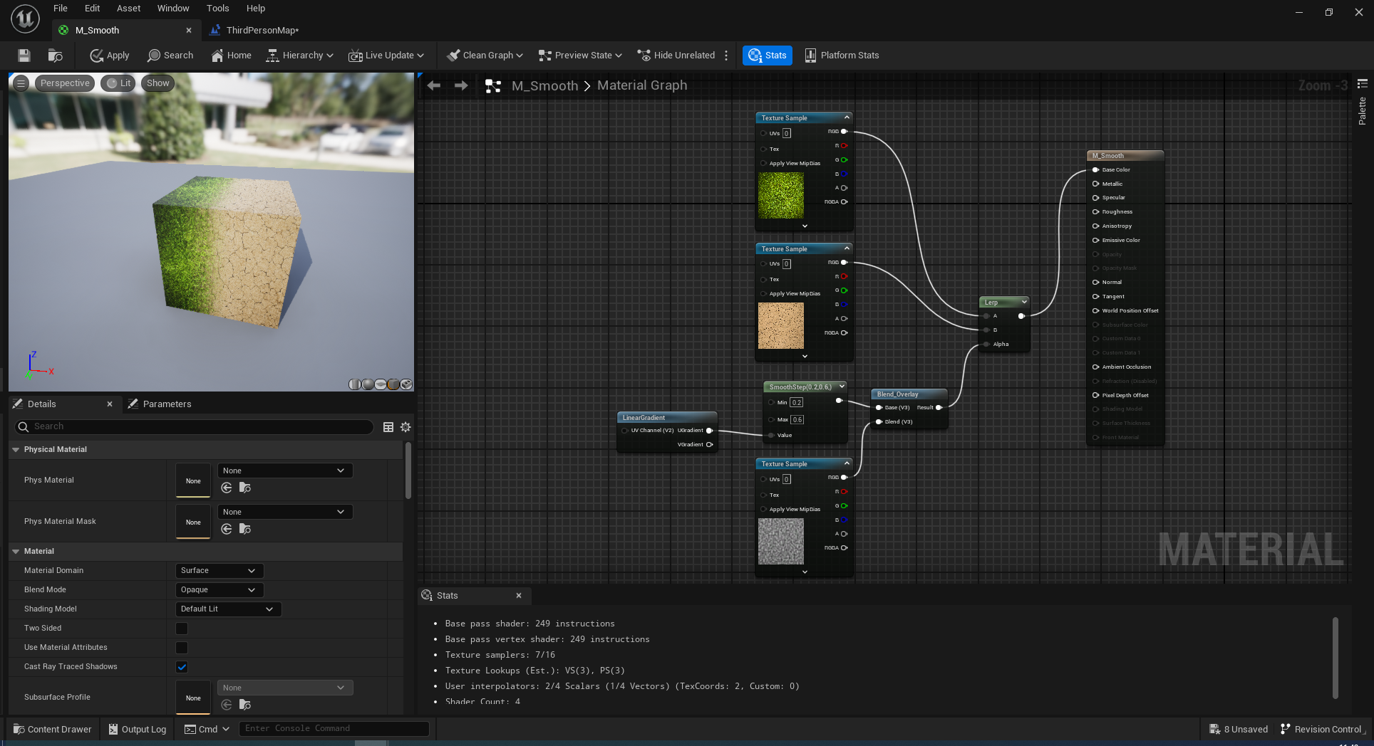

Slide 14
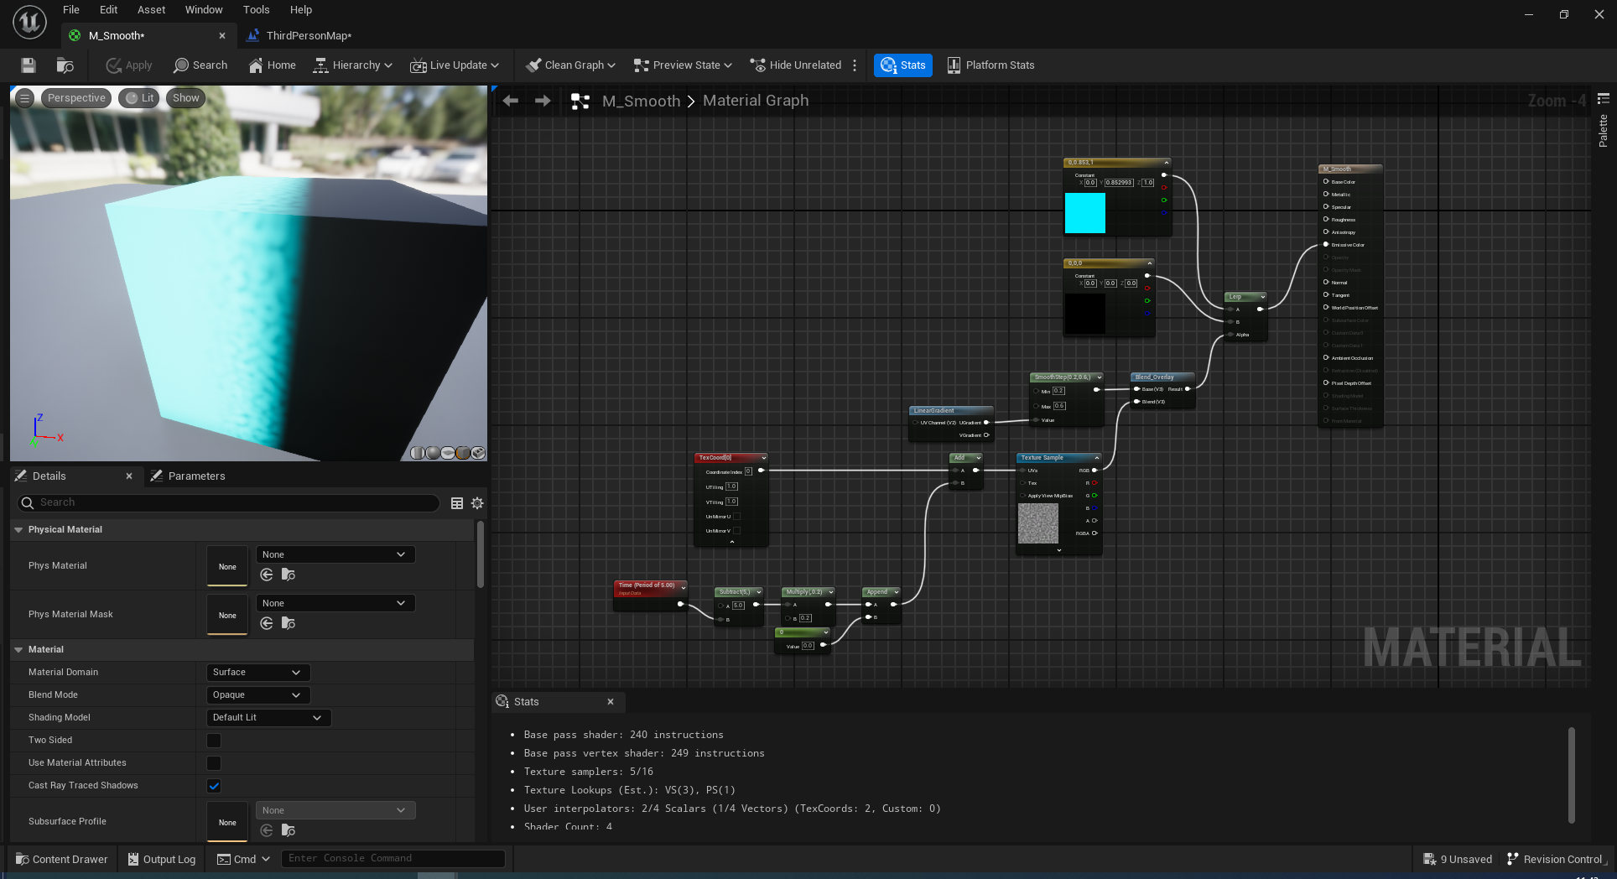
This one is for you to play around with in your own time ;)

Slide 15
Stencils
Masking things post process

Slide 16
Stencils
Stencils allow us to mask certain areas of the display to alter rendering effects in those areas.

Slide 17
Setup
Add a post-processing volume to a part of the scene we wish to apply the effect to.

Slide 18
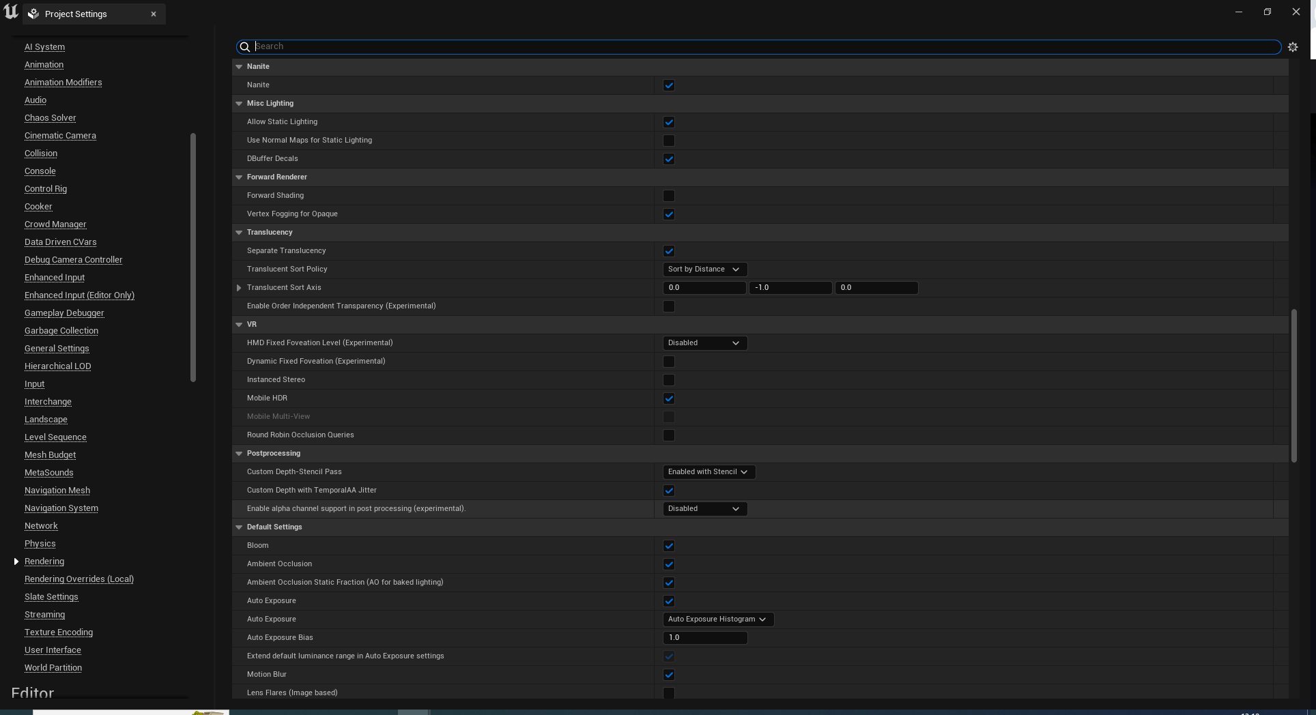
Set this or nothing happens

Slide 19
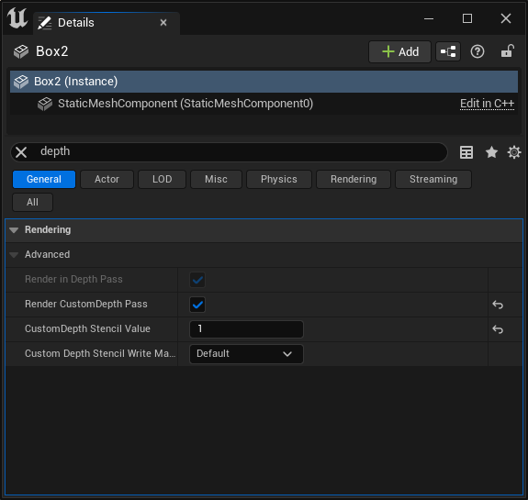
Enable a custom depth pass
The stencil values here specify different masks.
We can filter on these later to apply different effects.

Slide 20
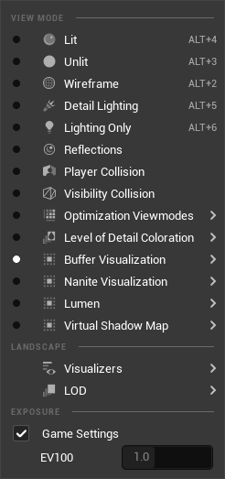
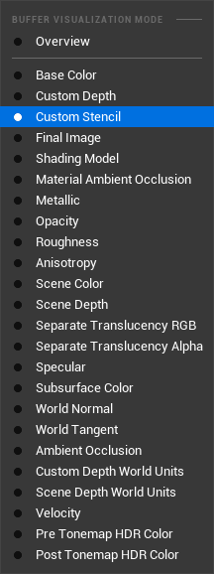
Check its working
Change the view mode to buffer visualisation, custom stencil

Slide 21
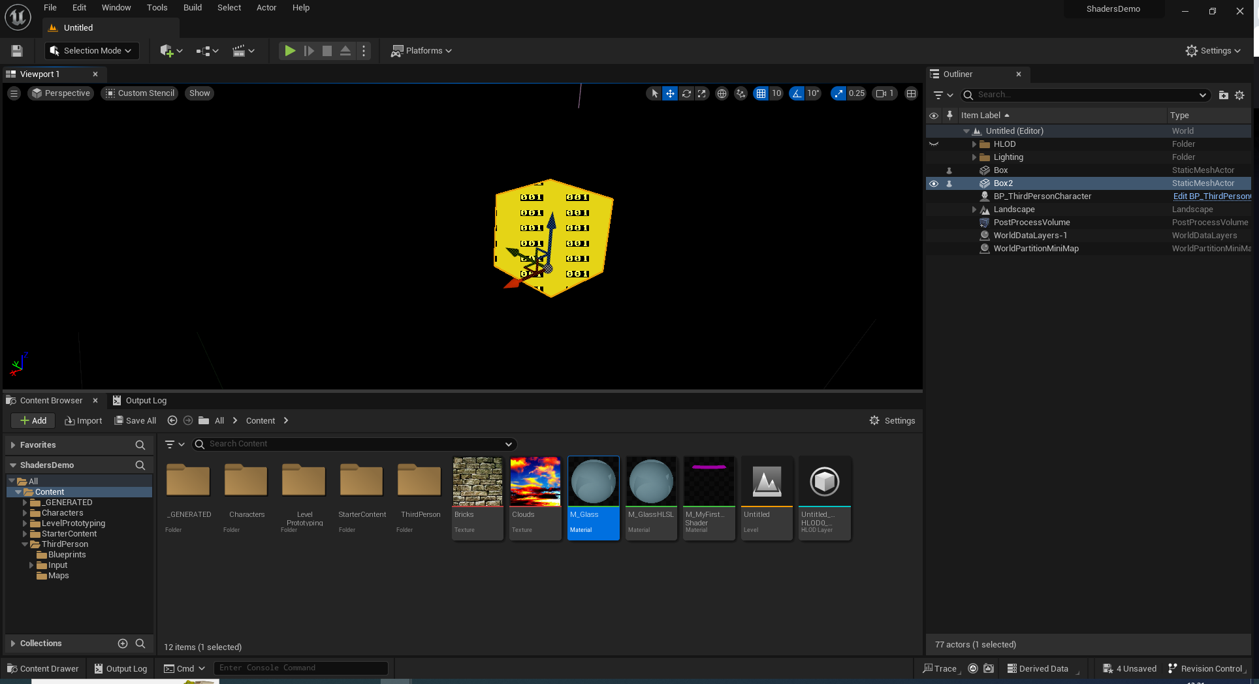

Slide 22
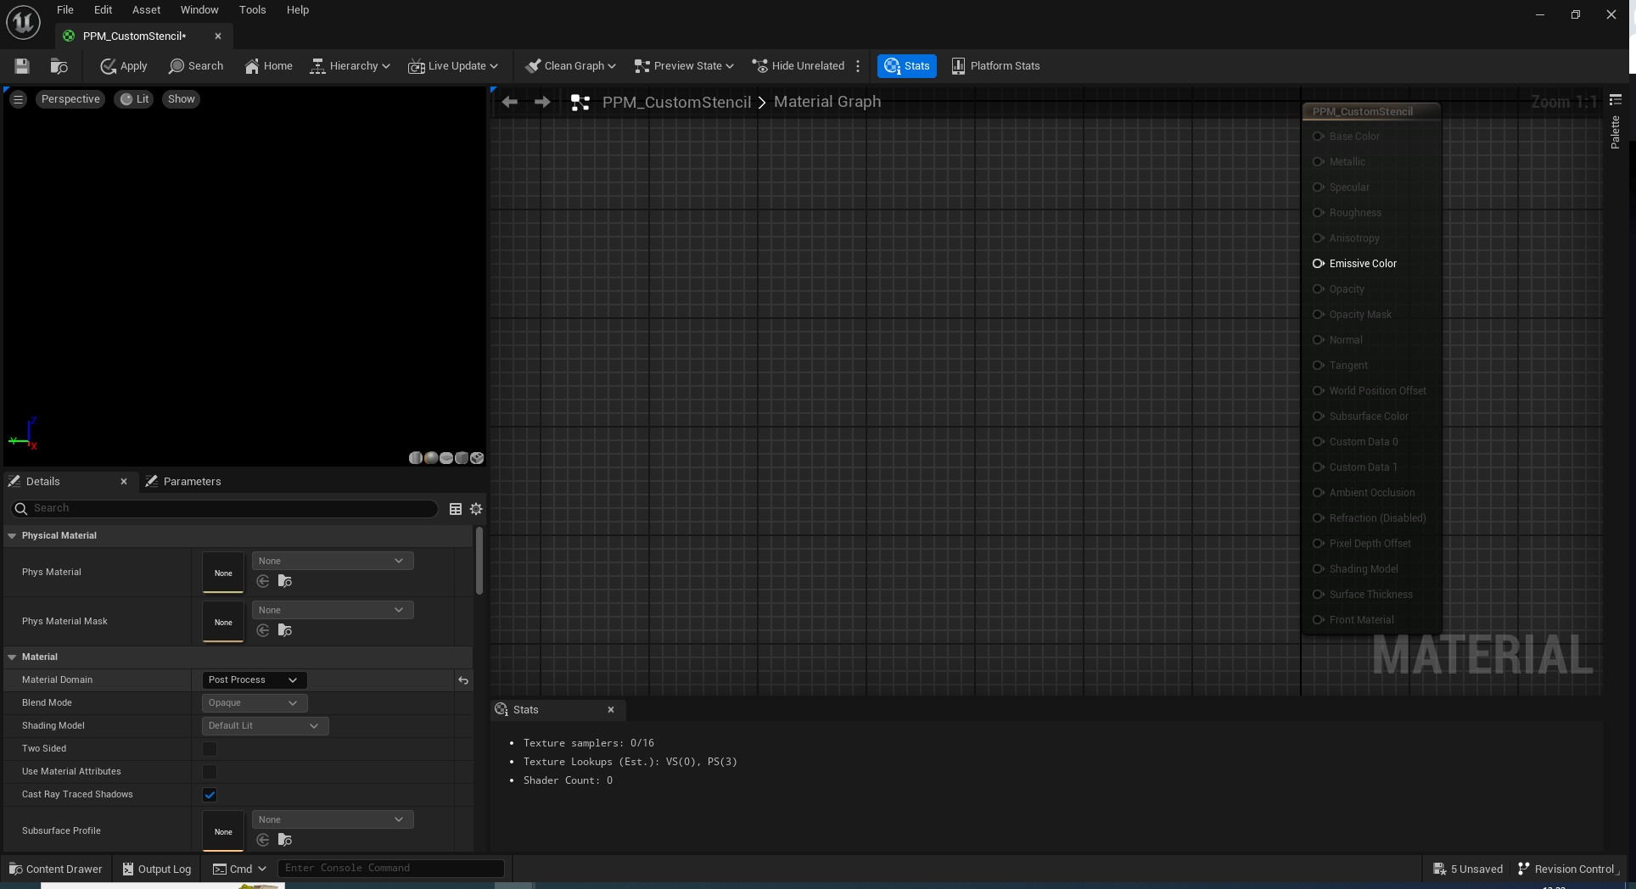
New Material Post Process

Slide 23
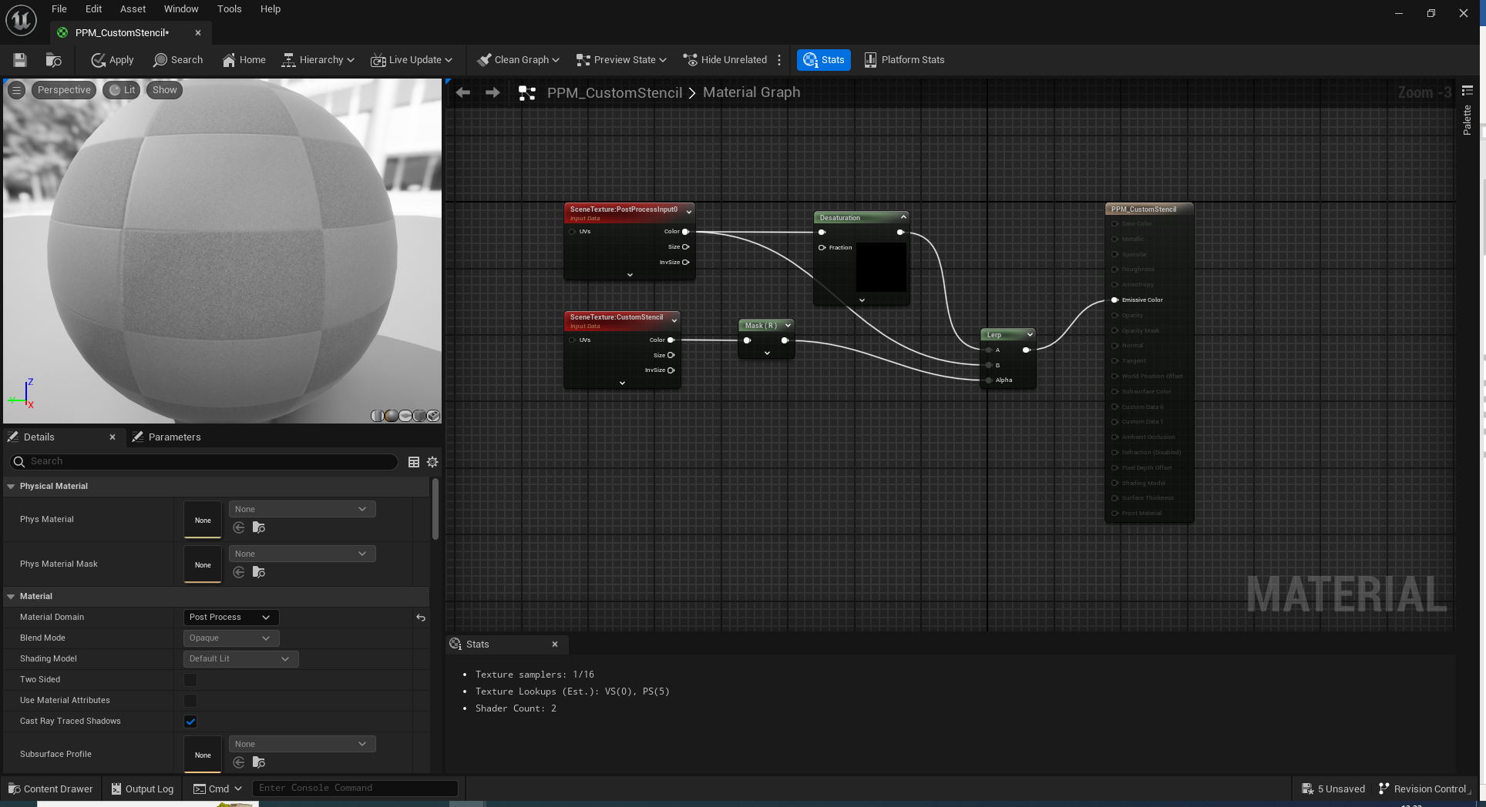

Slide 24
Gets the scene colour values prior to applying the post-processing effect
Gets the stencil numbers of different parts of the scene

Slide 25
Mask removes data channels we do not want.

Slide 26
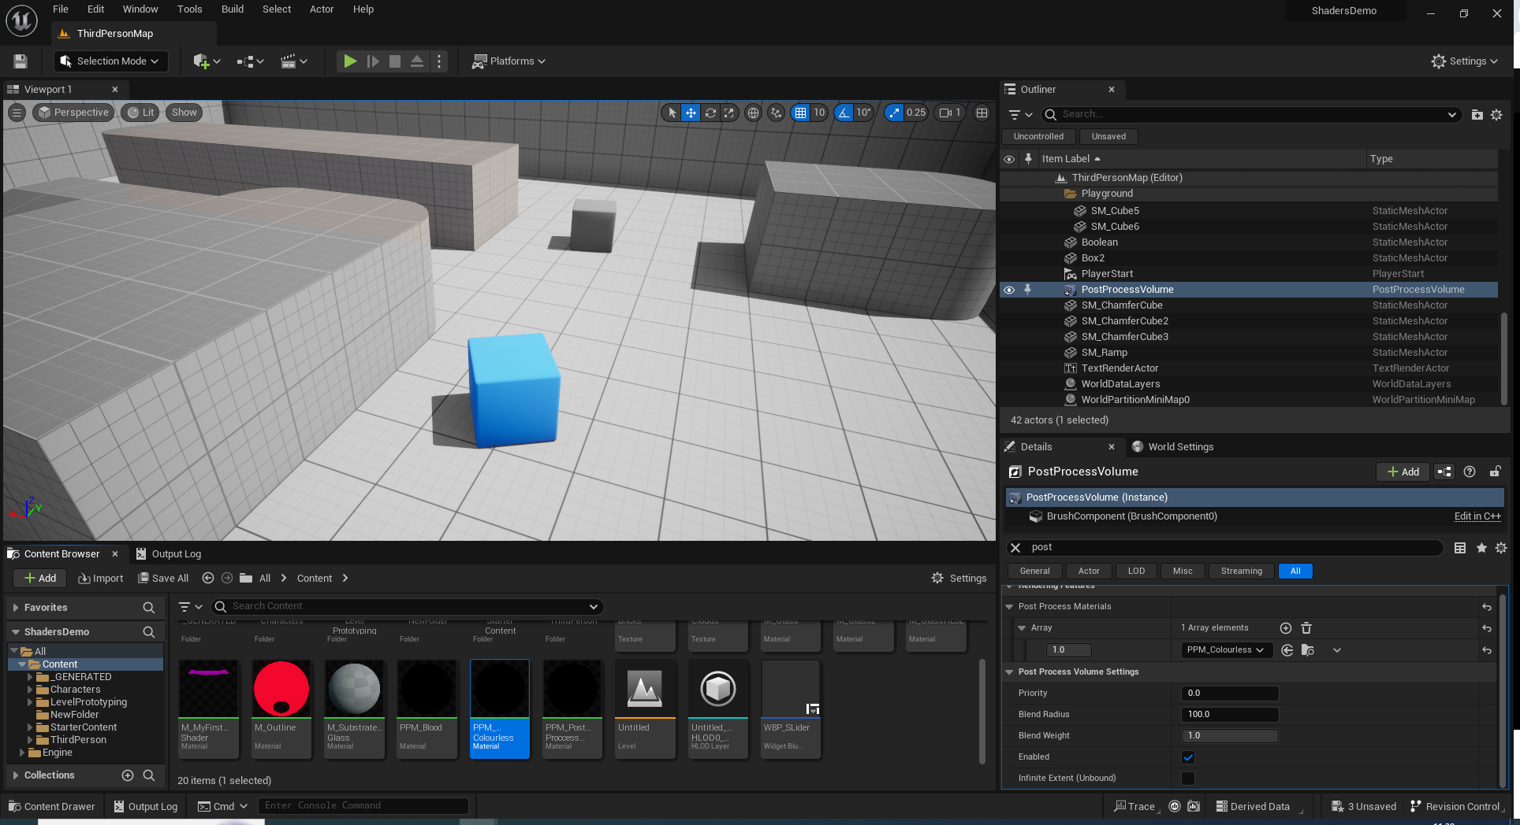

Slide 27
Dynamics
Adjusting at runtime

Slide 28
A couple of notes here:-
As this is rather difficult, I have provided a sample project.
It uses blueprints so you will have to convert it to C++ to use it in your assignment…
I may or may not attempt this live, it depends how brave I feel at the time.

Slide 29
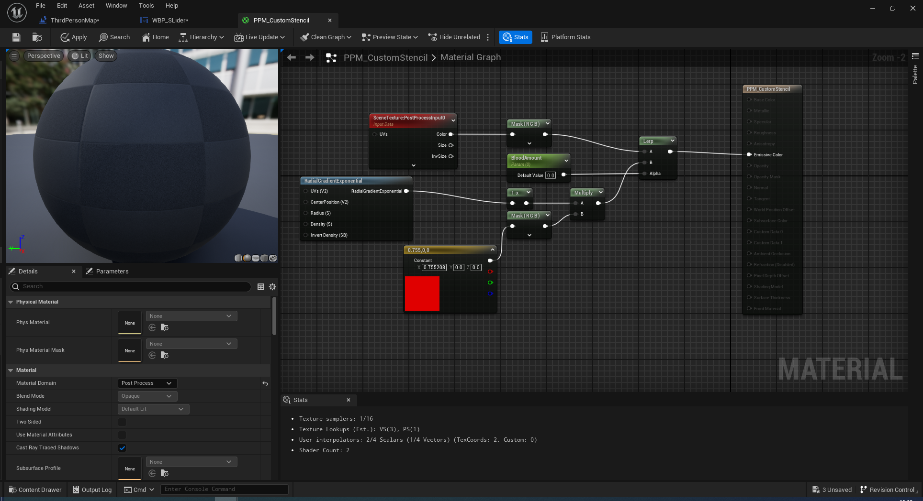

Slide 30
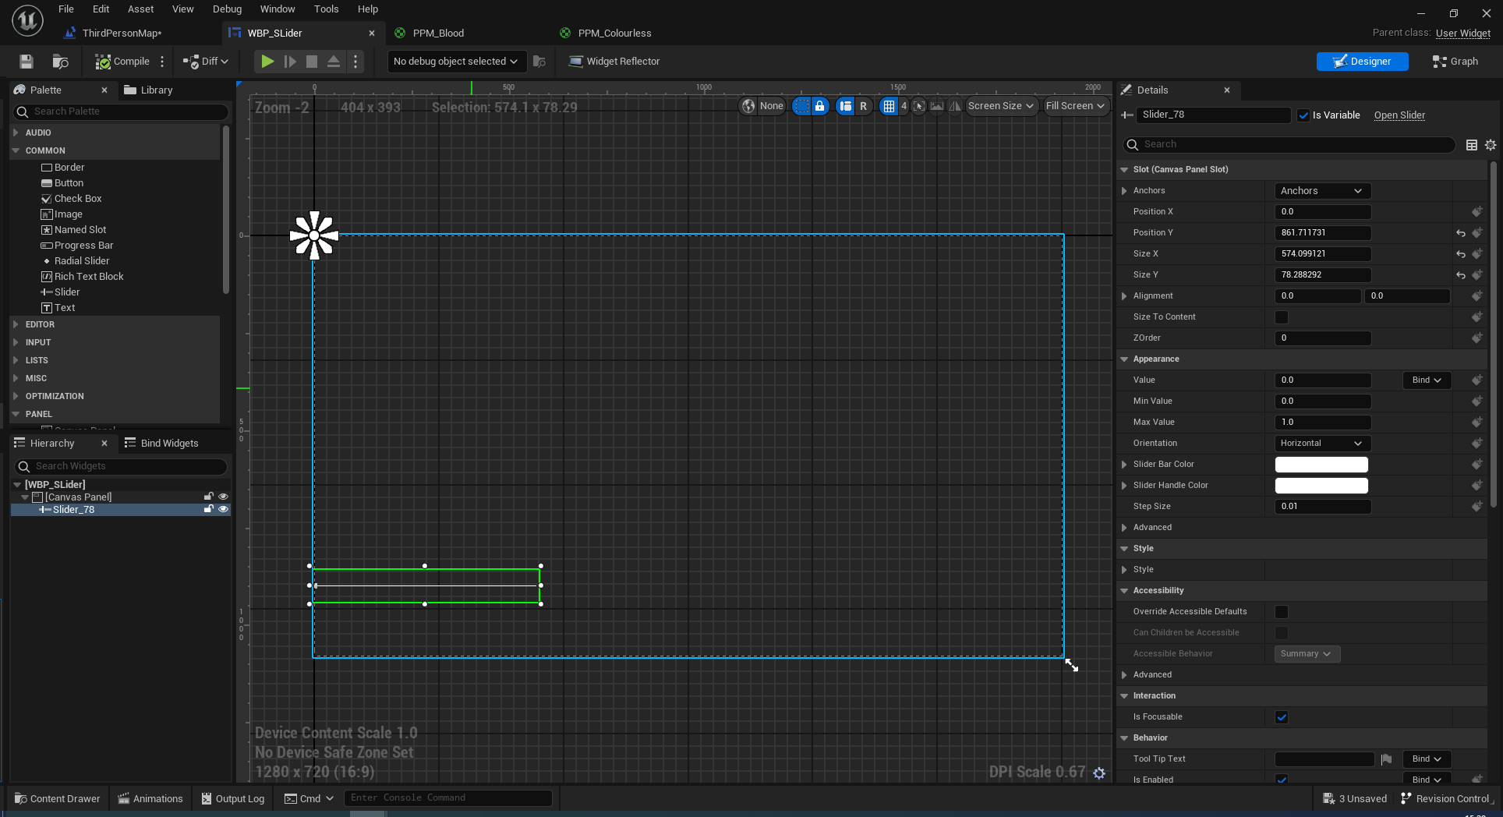

Slide 31
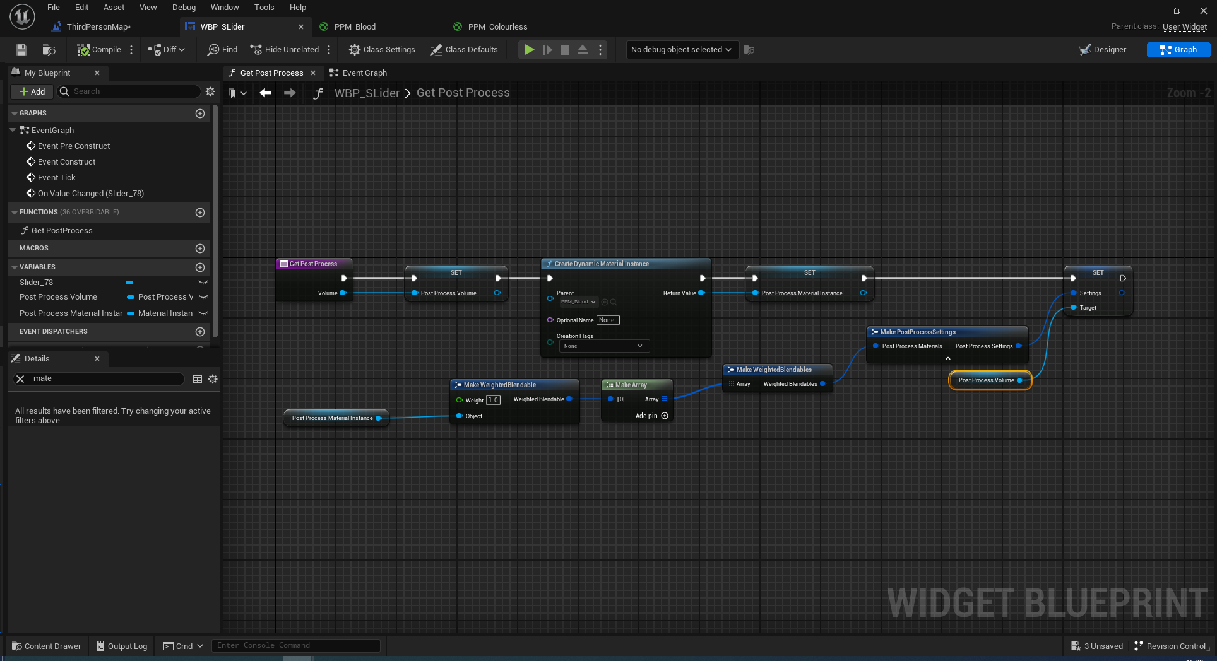
Dynamic Material means we can change the settings at runtime =)

Slide 32
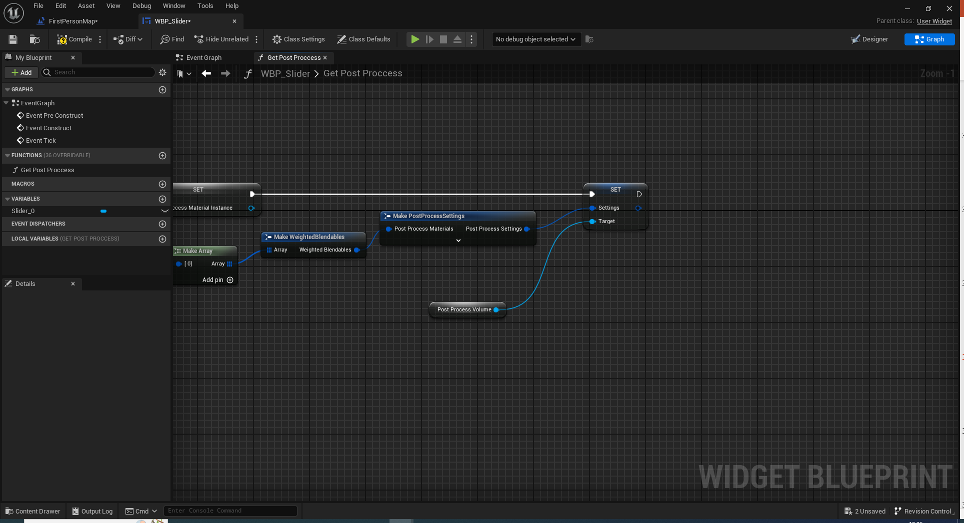
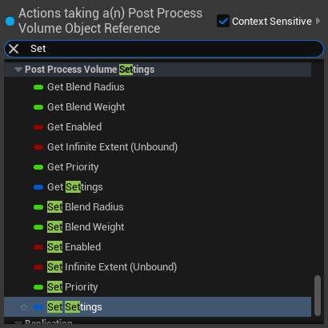
You need to turn on Post Process Materials here to expose the pin!
Drag off here to find this in context-sensitive mode!

Slide 33
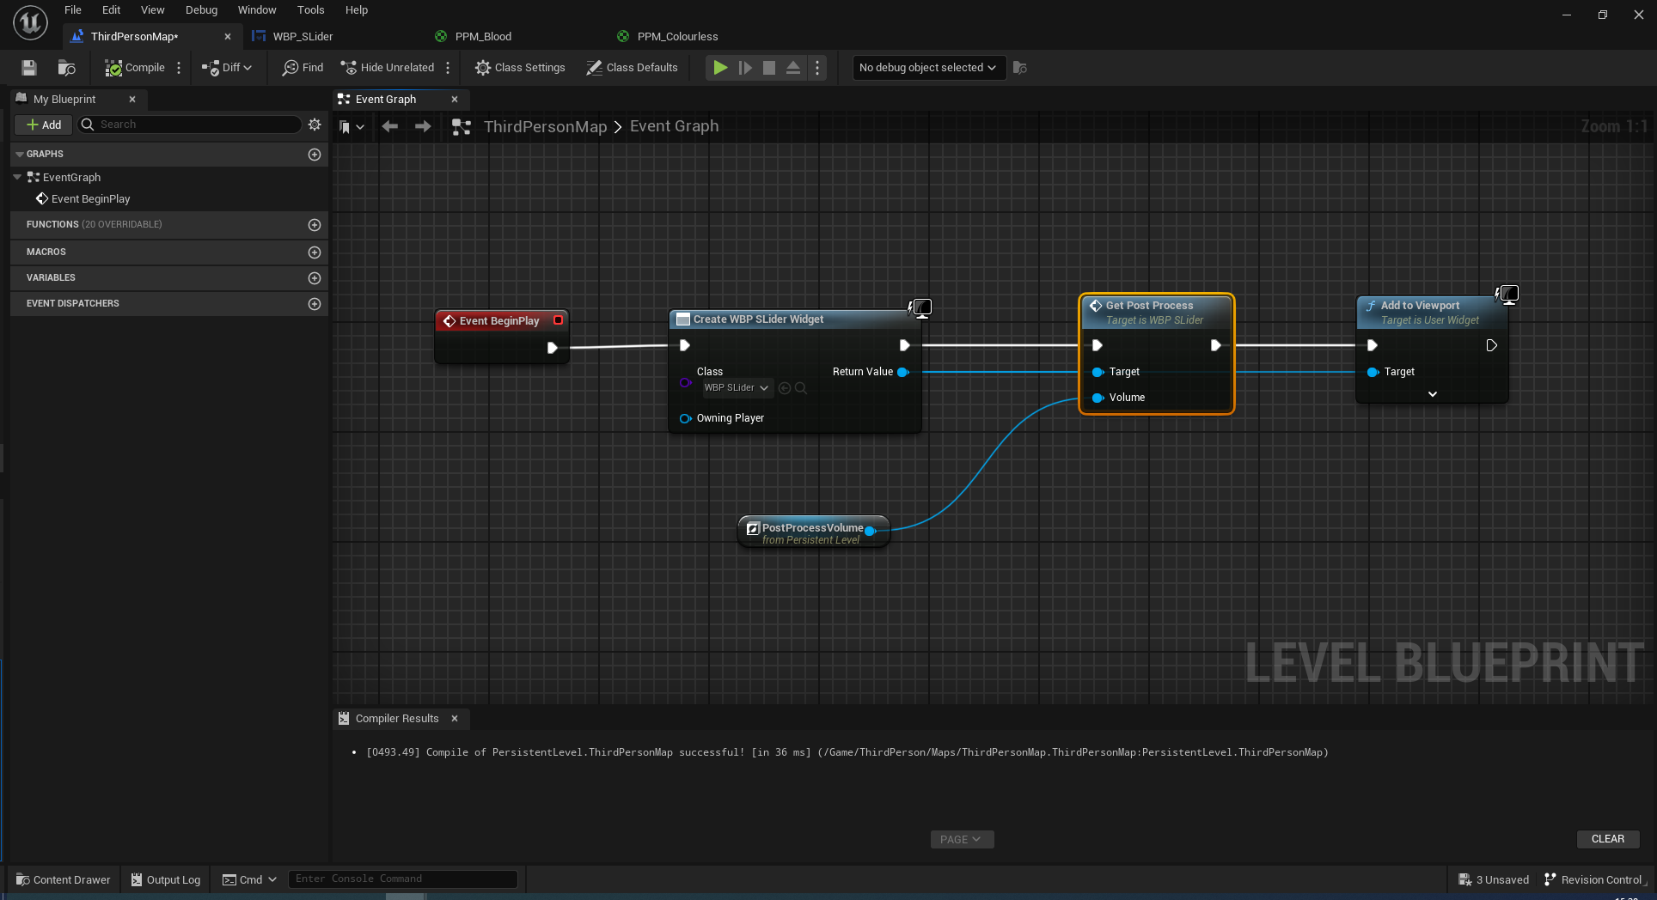

Slide 34
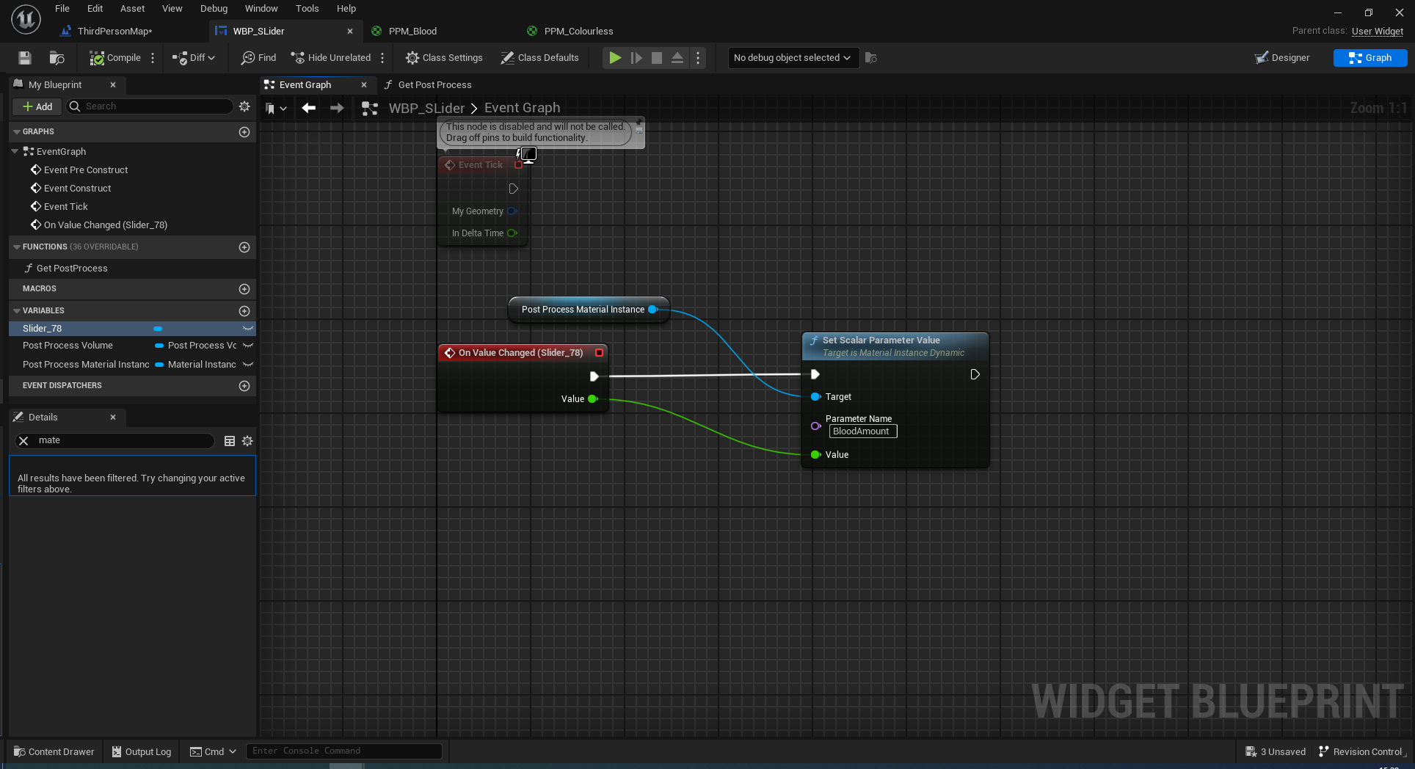
https://www.parallelcube.com/2018/12/09/post-process-volume/

